Slide 1
PhotoDiary App
Boyang An, Zhenyu Han, Zehua Shao, Jerry Wang

Slide 2
Idea
You’ve been to awesome places and took great photos, use PhotoDiary and show them to your friends!
Add your photos to a map and build your own travel map!

Slide 3
Features
Application will organize user photos based on exif tag information
Display user photo thumbnail next to exact location on a google map
Aggregate user photo data, display all photos with respect to location on world map
Clustering will display photos close together as 1 marker, synchronization of photo data after user takes a photo while using app
User profile creation + Login

Slide 4
APIs used
External libraries:
Google Maps API+Google play services
Google Maps utils library
SQLite

Slide 5
Project Structure
StartupActivity:
launches new login / new register intent, depending on button clicked
LoginActivity:
reads from database for existing user
RegisterActivity:
creates user based on text entered in screen
DatabaseHelper
2 tables used: one table for storing user profile, one table for storing photos of user
if login is successful, main activity is launched. If login fails, user must create profile first
MainActivity
upon launch, creates new google map
calls on other methods to get data from photos stored on phone, set markers on google map according to data obtained

Slide 6
project structure cont.
helper classes:
DiaryPhoto
stores data about a single photo entry: photo name, photo’s gps latitude, longitude, time taken, android uri, user id
User
stores data about each user profile created: name, password, email
ImageInfoWindowAdapter
helps inflate thumbnail of photo onto view if marker is clicked
Some others ...

Slide 7
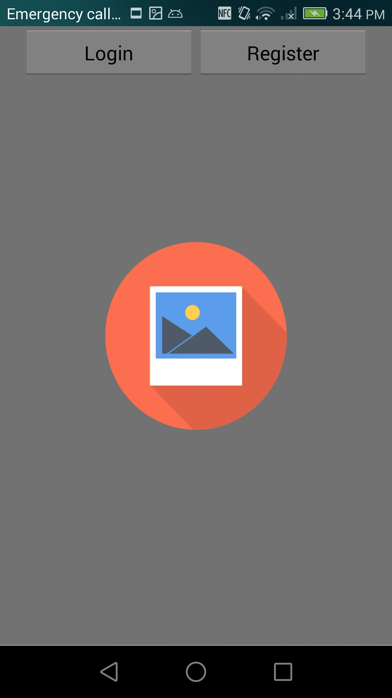
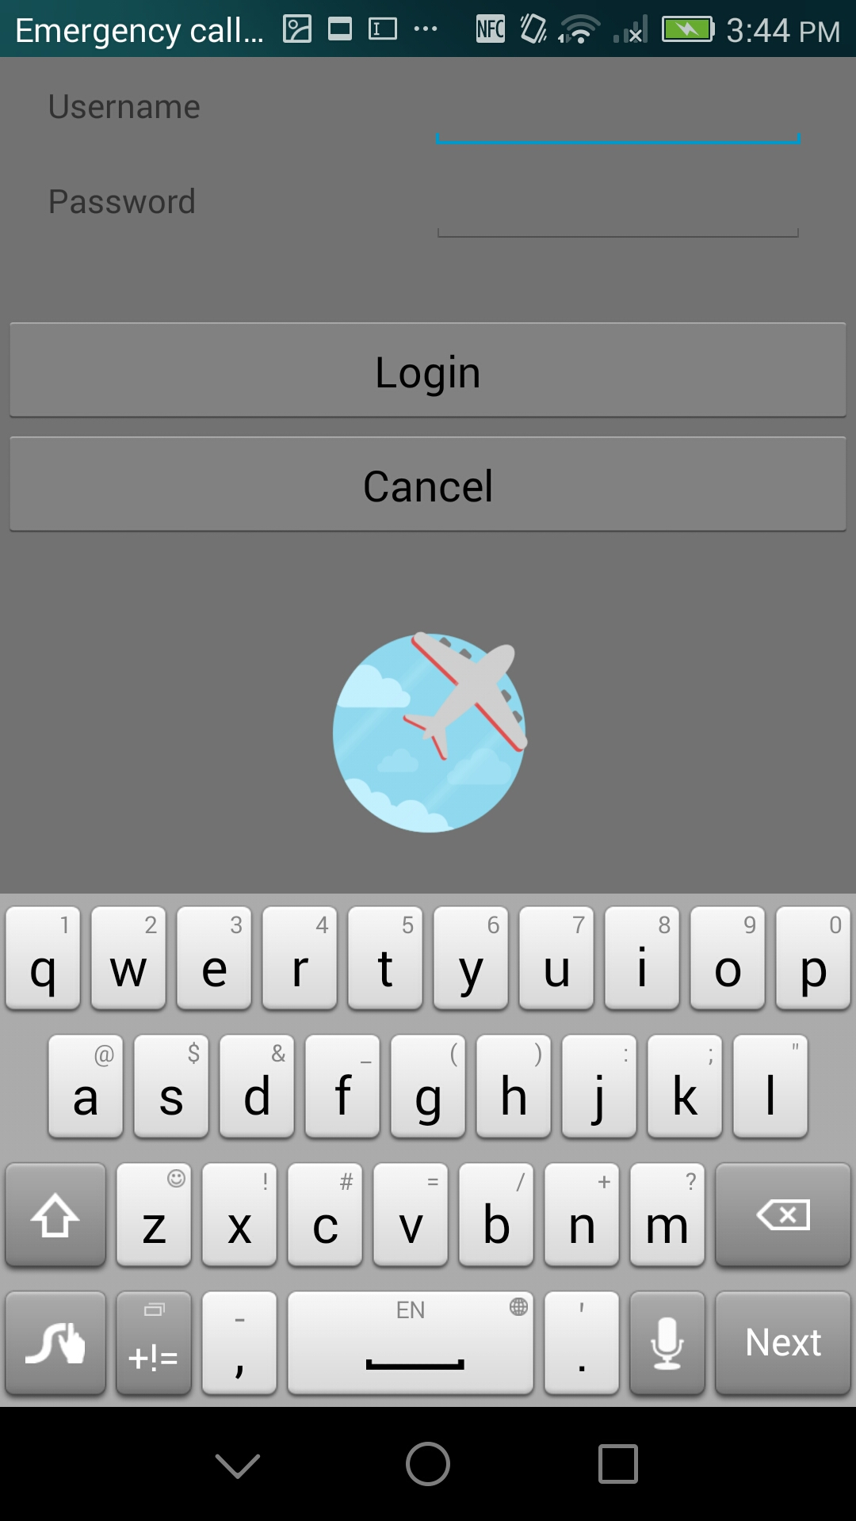
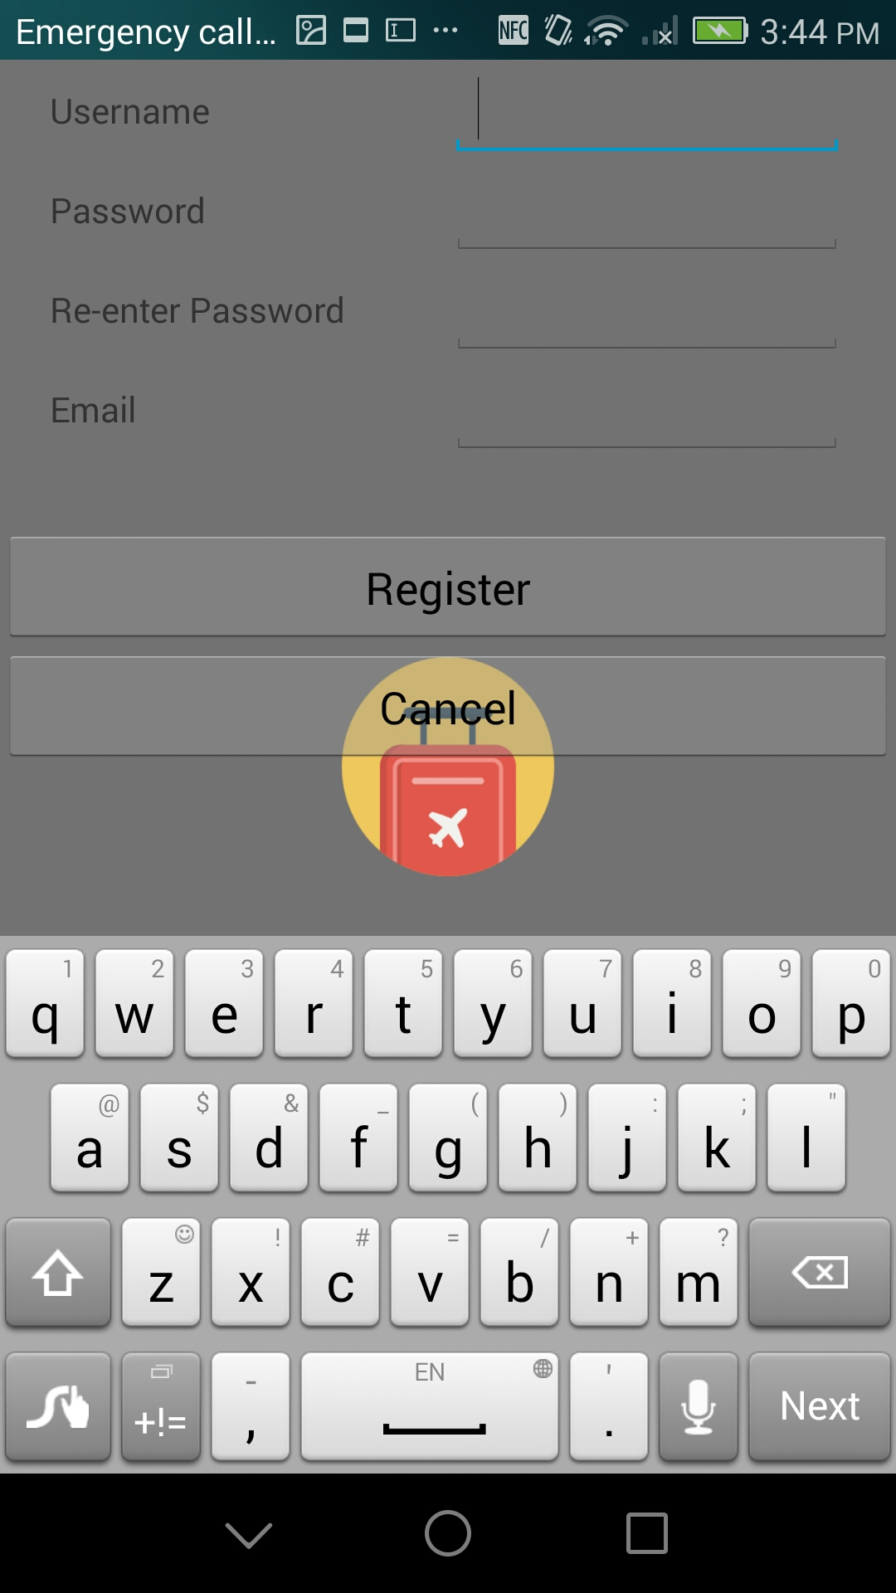
Startup Screen login register

Slide 8
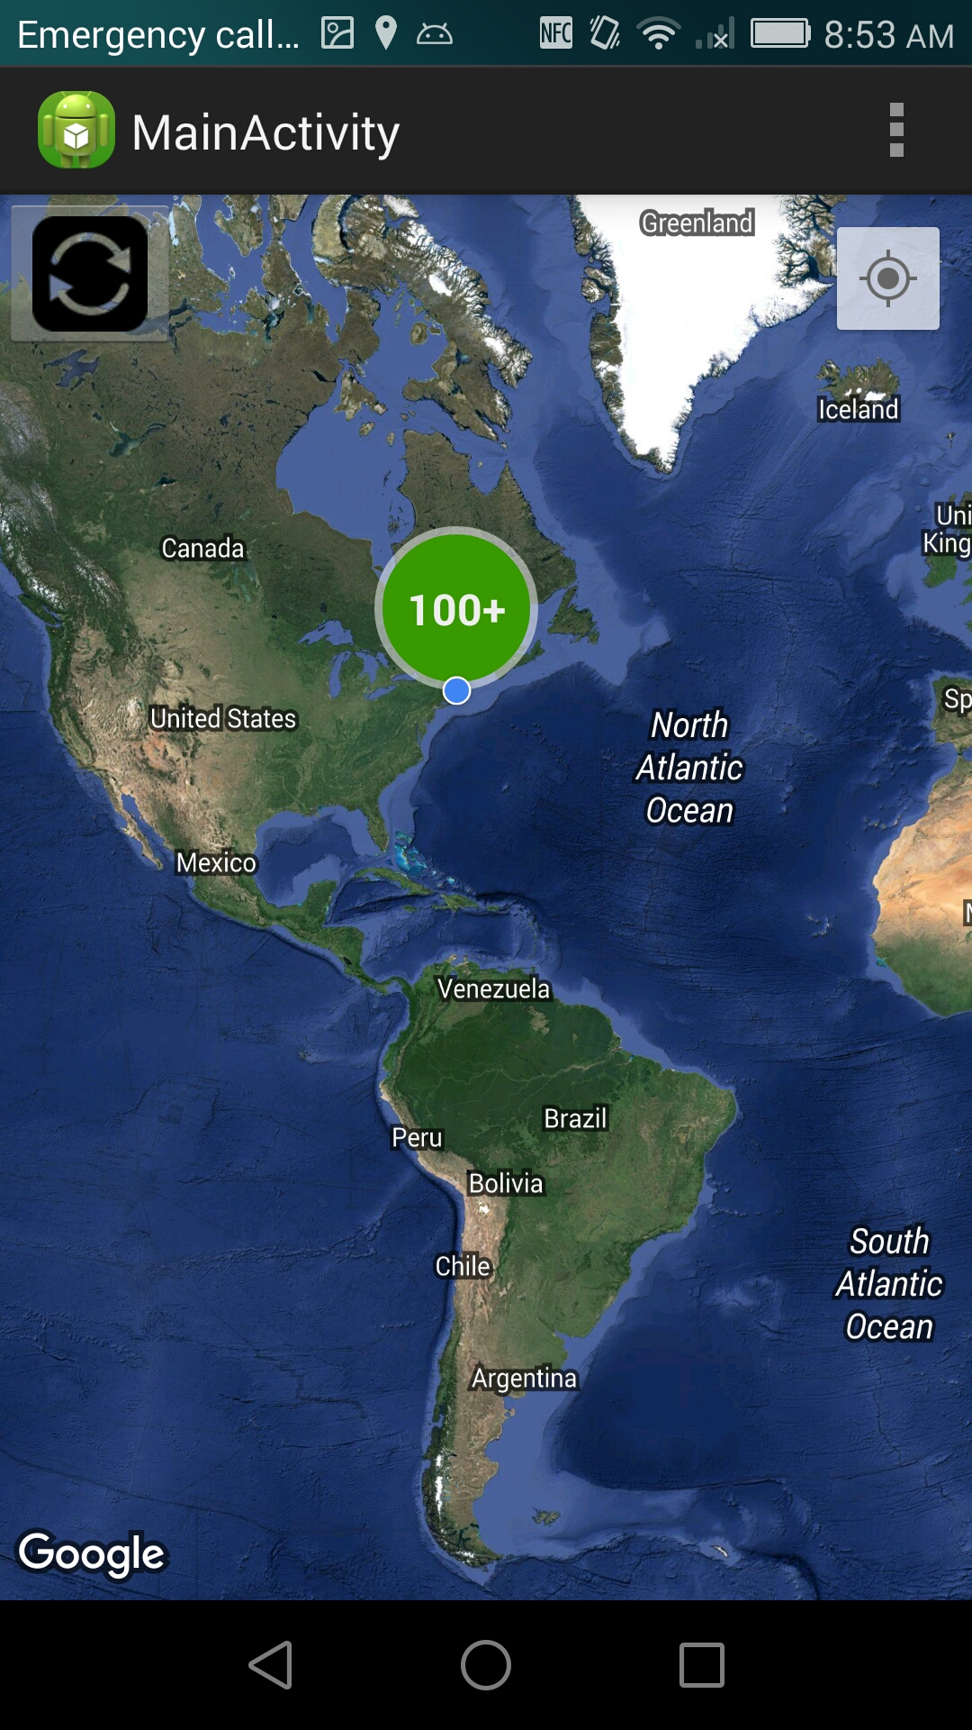
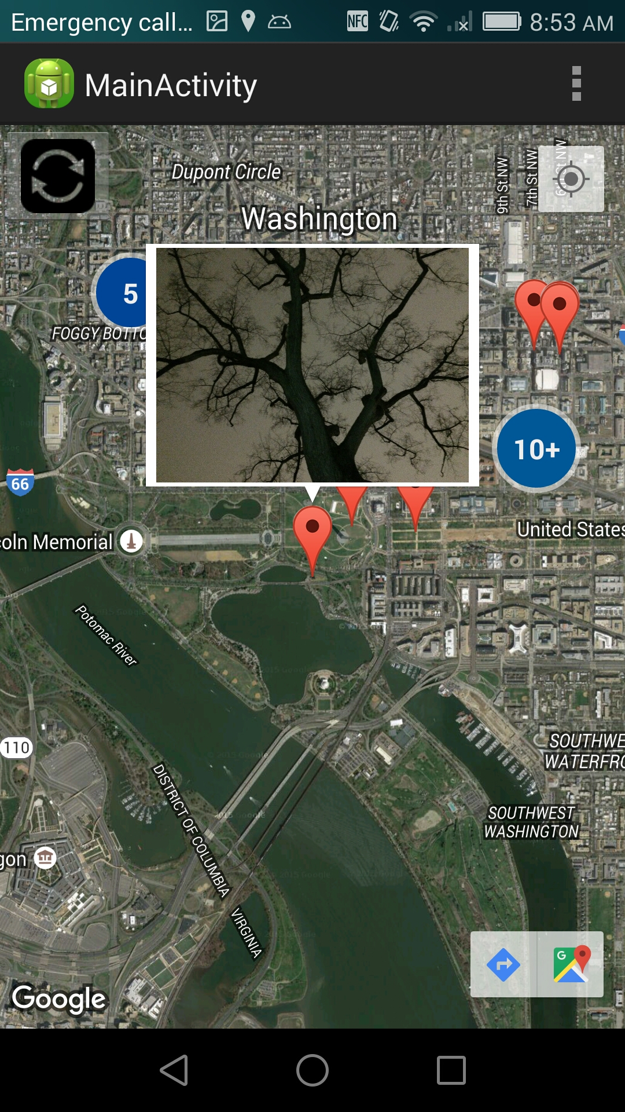
Main User Interface
Implement the Map Fragment to show Google Map.
Basically, this view has build the connections between the photo with its geologic information which allows people to retrieve where they have actually taken this picture.
In order to build the connections we need to visualize 3 widgets: individual marker, cluster and their infowindow which will show the picture up.

Slide 9
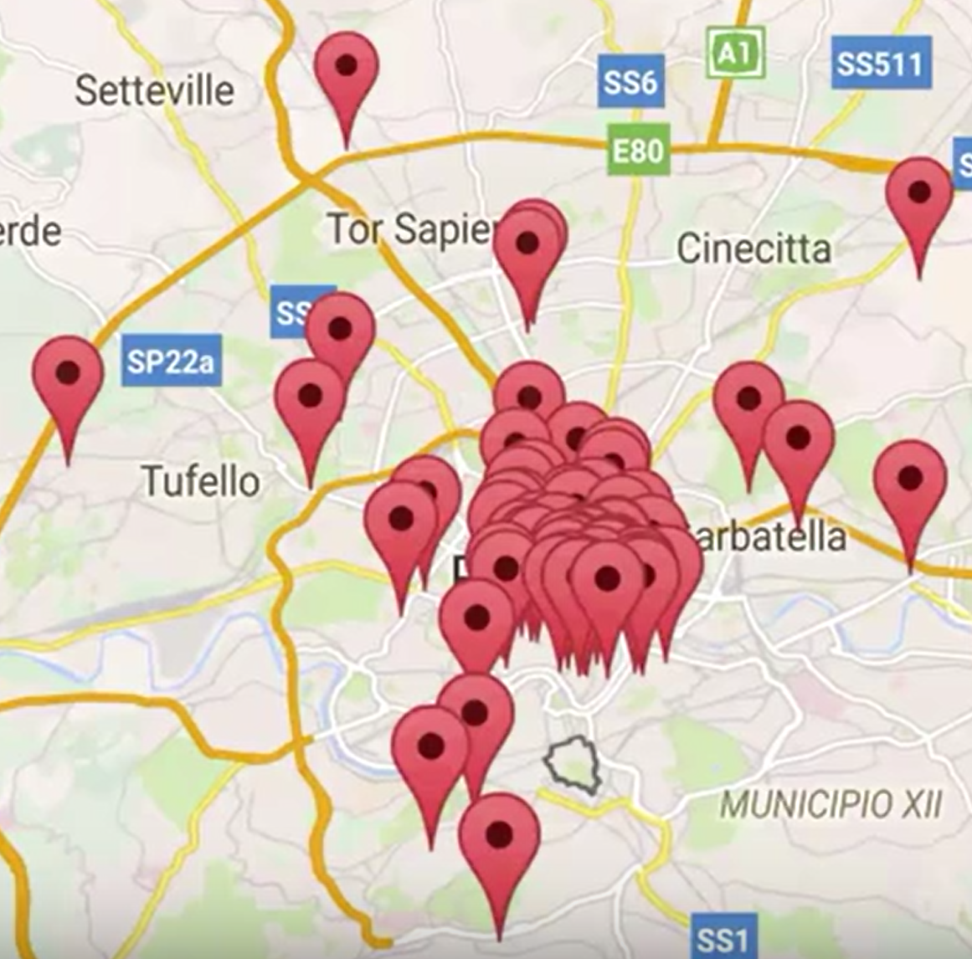
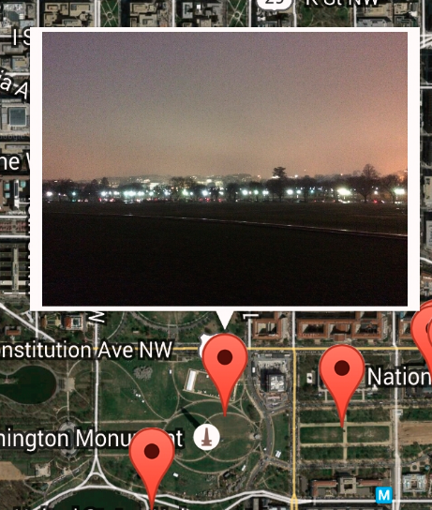
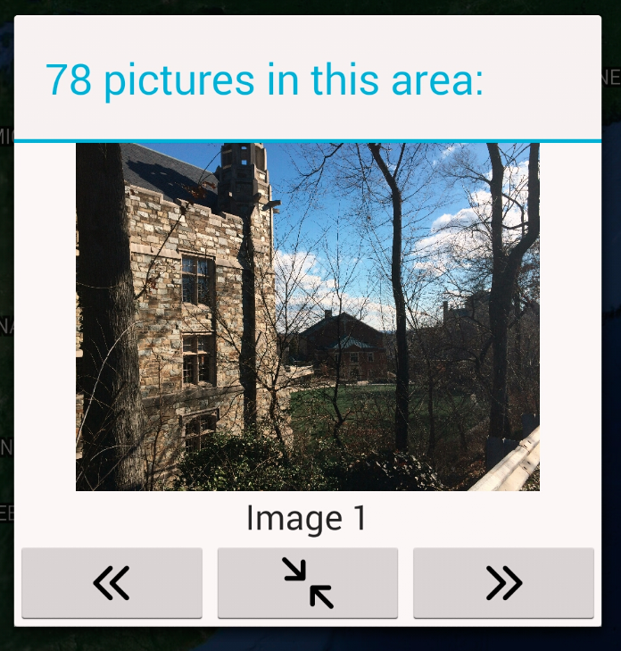
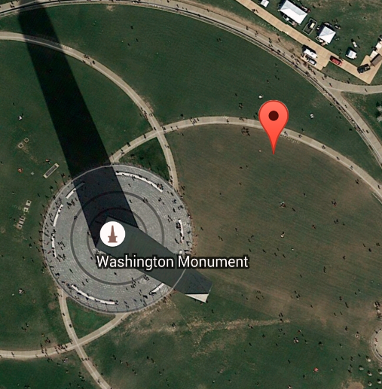
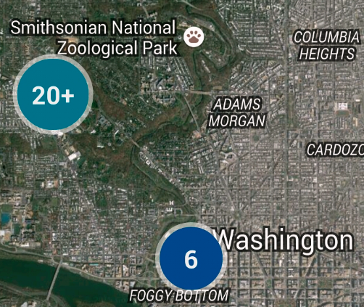

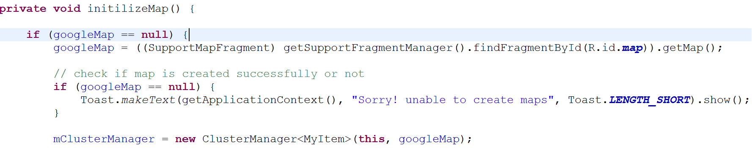
Main User Interface 2
Default View
individual marker
cluster marker
Infowindow / Dialog

Slide 10
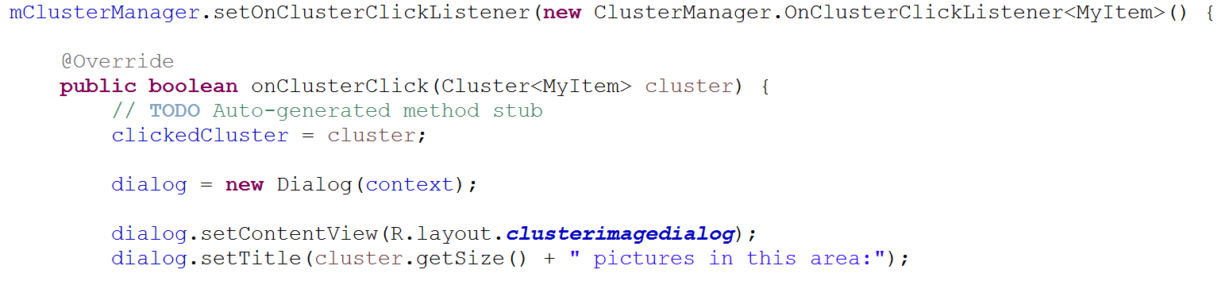
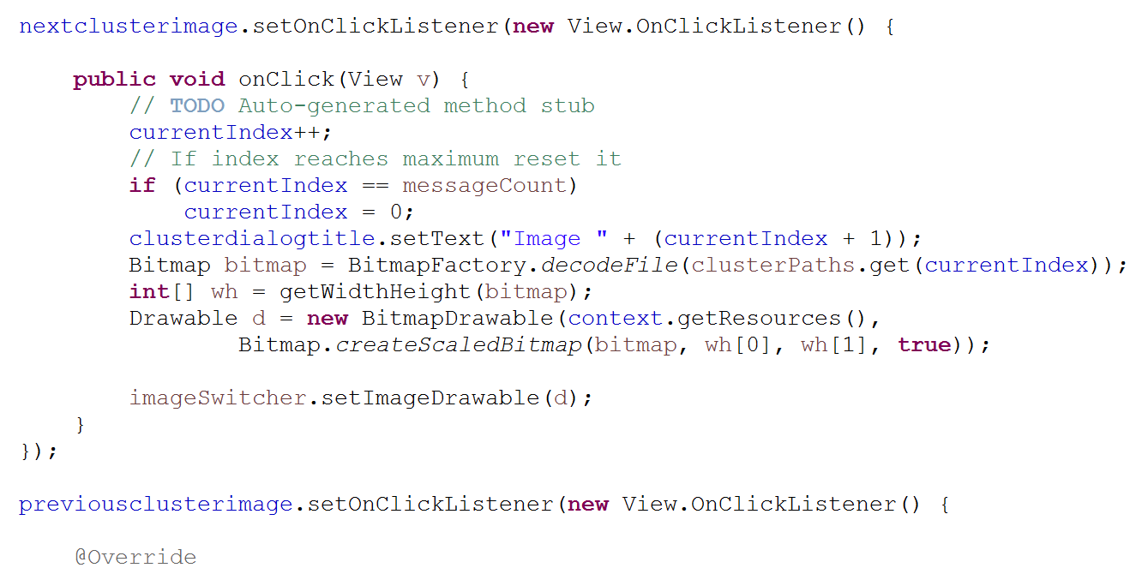
Main User Interface 3
…...

Slide 11
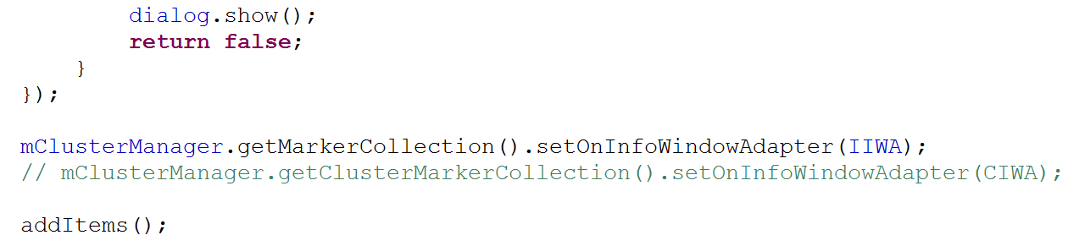
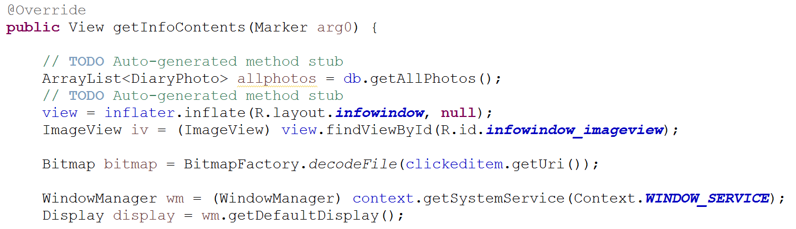
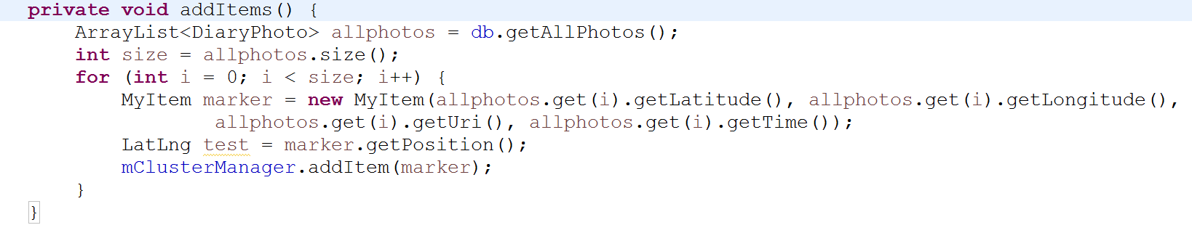
Main Interface 4

Slide 12
Geo-Tagging
Exif tag: information stored within jpeg file of photos taken on phone
user can enable/disable ‘geo-tagging’ via security preferences. This app requires photo to have a geo-tag to be displayed on map
Exif interface allows extraction gps coordinates, time taken, altitude taken-all from the jpeg file itself
thumbnail displayed must first convert photo into smaller bitmap image

Slide 13
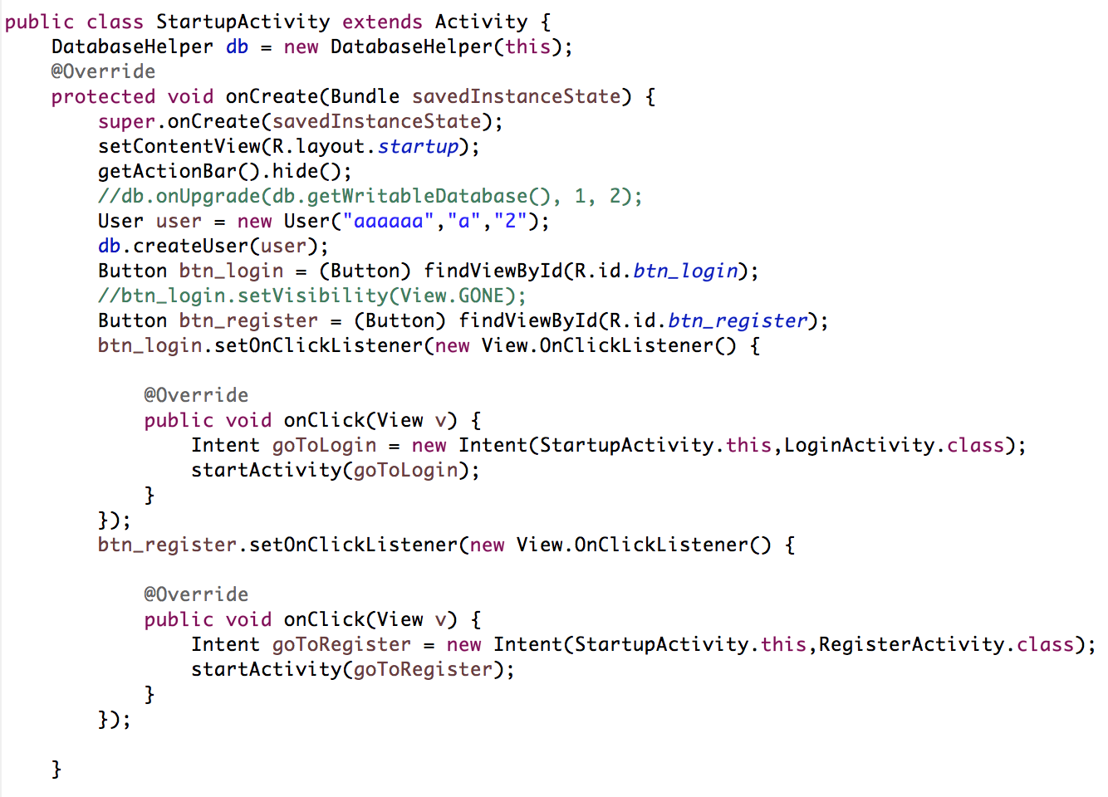
StartupActivity

Slide 14
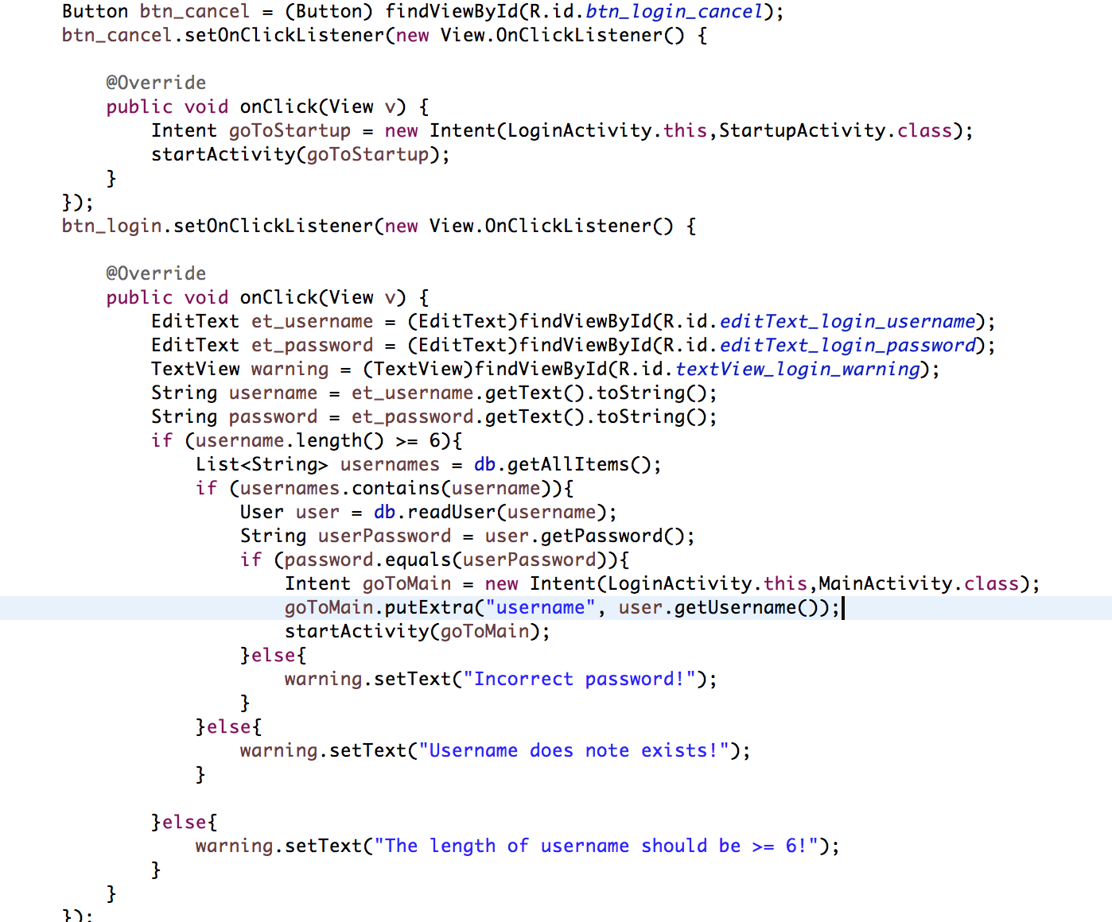
LoginActivity

Slide 15
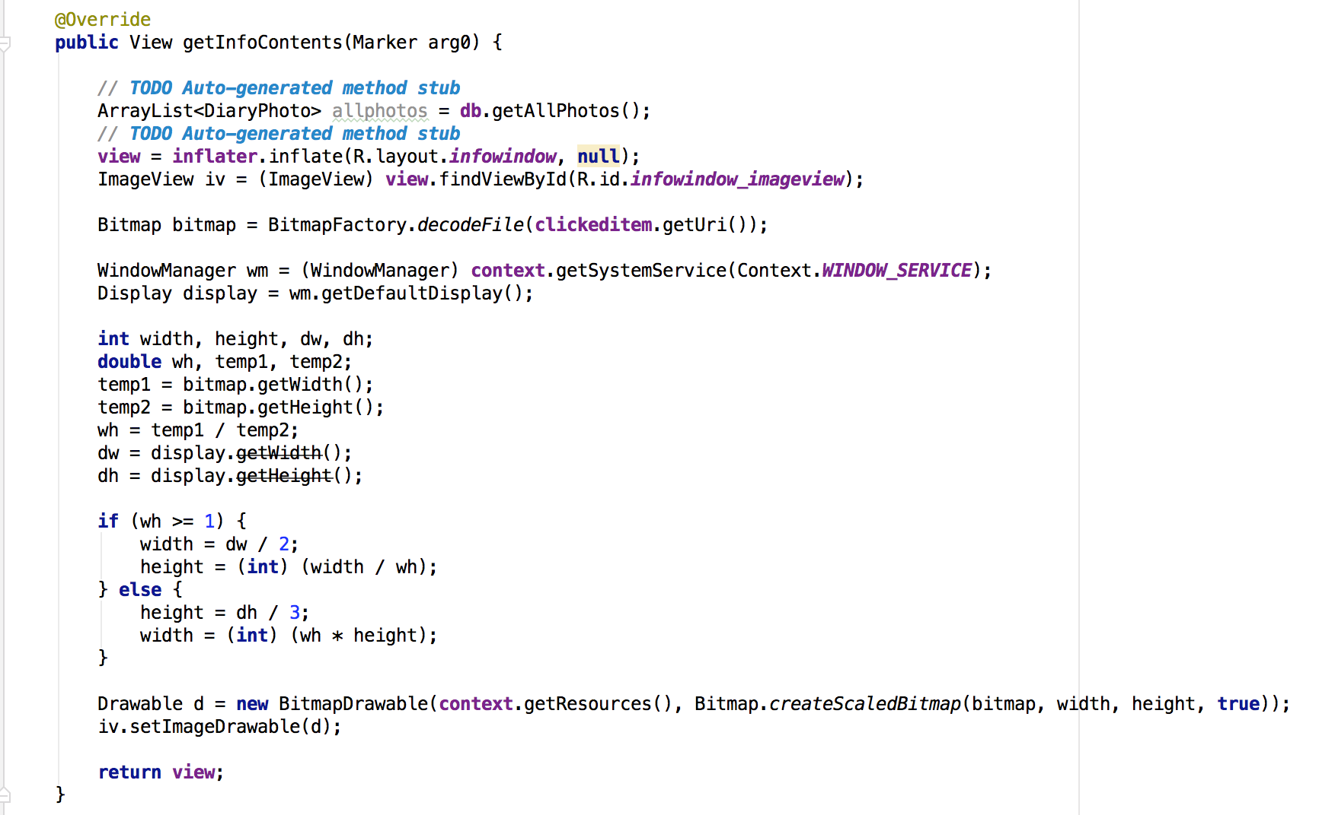
image info window adapter

Slide 16
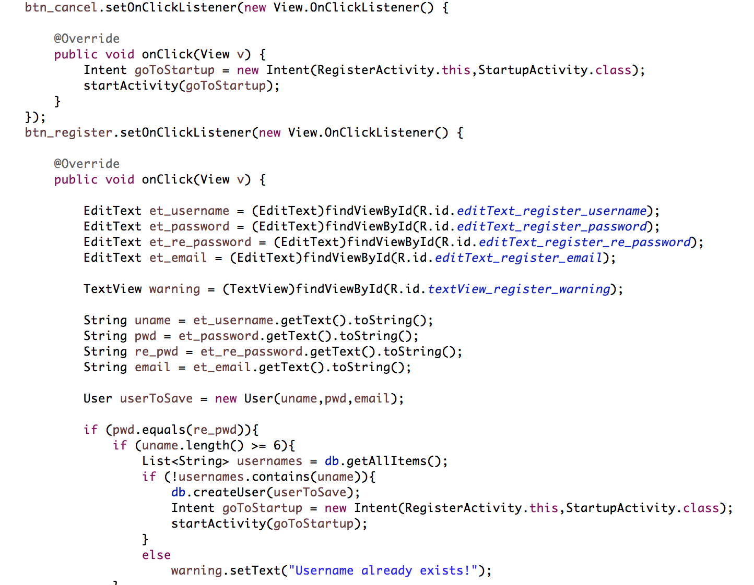
RegisterActivity

Slide 17
DatabaseHelper
Methods:
onCreate: create user table and diaryphoto table, if not exist
onUpgrade: only drop if exists
createUser and createDiary
readUser and readDiary
getAllPhoto: read all photos from database
getAllItem: read all users from database
deleteUser: delete user

Slide 18
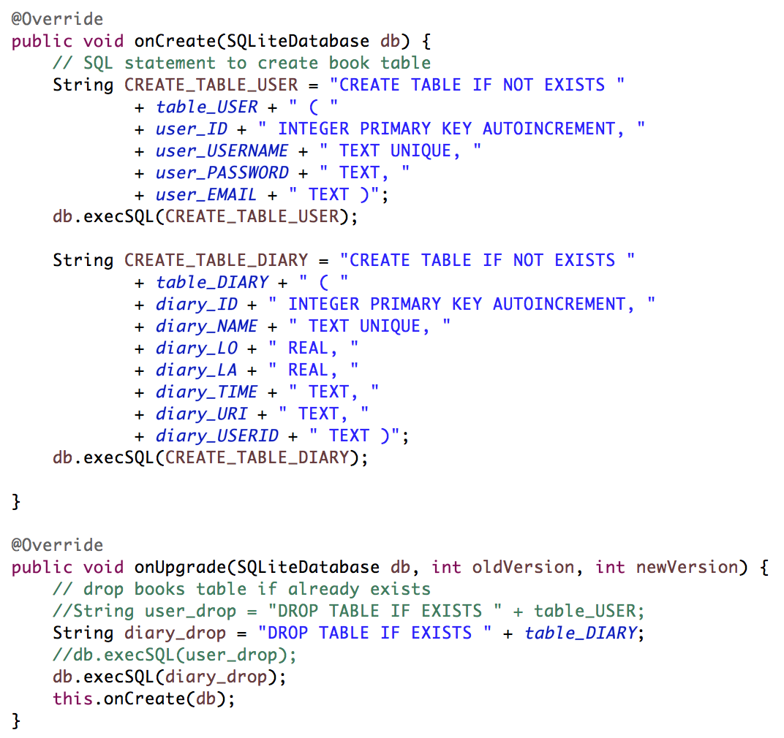
DatabaseHelper

Slide 19
DEMO TIME

